Slide 1
Regression Analysis
Source of Material:
Data Science and Big Data Analytics, EMC Education Services, John Wiley & Sons, 2015

Slide 2
Outline
Purpose of regression models
Typology of regression models
Multiple regression model
Derivation of regression coefficients
Assumptions of linear regression
Model validation

Slide 3
Purpose of Regression Models
Explaining the average effect of inputs on an outcome variable (classical statistical inference)
Predicting the outcome variable for new records (i.e., predictions that the model can generate for new records)
In other words, we build regression models to explain and to predict phenomena.

Slide 4
Purpose of Regression Models
Comparison of Explanatory and Predictive Regression Models
Explanatory Models | Predictive Models
A good model is one that fits the data closely | A good model is one that predicts new records accurately
The entire dataset is used to estimate the best fit model for explanatory power | The data are typically split into a training set and a validation set. Training set is used to estimate the model and the validation set is used to assess predictive performance on new, unobserved data
Performance measures measure how close data fit the model and how strong the average relationship is. | Performance is measured by predictive accuracy (i.e., how well the model predicts new individual records)
Explanatory model focus on coefficients (β) | Predictive models focus on the predictions (ŷ)

Slide 5
Typology of Regression Models
Type of outcome variable
Continuous
Linear
Non-
linear
Discrete
Binary
Multi-nomial
Multiple Regression
Logistic Regression

Slide 6
Multiple Regression
Regression analysis attempts to explain the influence that input (independent) variables have on the outcome (dependent) variable
Questions regression might answer
What is a person’s expected income?
What is probability an applicant will default on a loan?
Regression can find the input variables having the greatest statistical influence on the outcome
Then, can try to produce better values of input variables
E.g. – if 10-year-old reading level predicts students’ later success, then try to improve early age reading levels

Slide 7
Linear Multiple Regression
Models the relationship between several input variables and a continuous outcome variable
Assumption is that the relationship is linear
Various transformations can be used to achieve a linear relationship
Linear regression models are probabilistic
Involves randomness and uncertainty
Not deterministic like Ohm’s Law (V=IR)

Slide 8
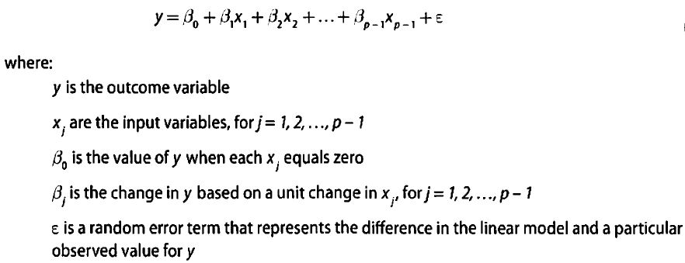
Multiple Regression Model Description

Slide 9
Multiple Regression Use Cases
Real estate example
Predict residential home prices
Possible inputs – living area, #bathrooms, #bedrooms, lot size, property taxes
Demand forecasting example
Restaurant predicts quantity of food needed
Possible inputs – weather, day of week, etc.
Medical example
Analyze effect of proposed radiation treatment
Possible inputs – radiation treatment duration, freq

Slide 10

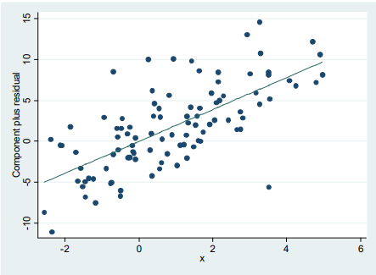



Derivation of Regression Coefficients
Ordinary Least Squares (OLS): minimizes squared residuals (best line of fit)

Slide 11

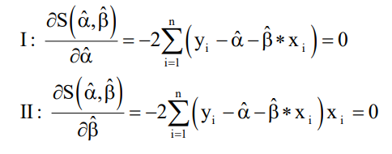
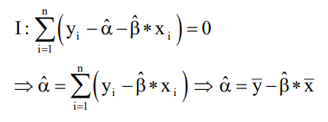
Derivation of Regression Coefficients
First-Order Conditions
(based on the first derivative)
Solving the first equation for alpha (α)

Slide 12
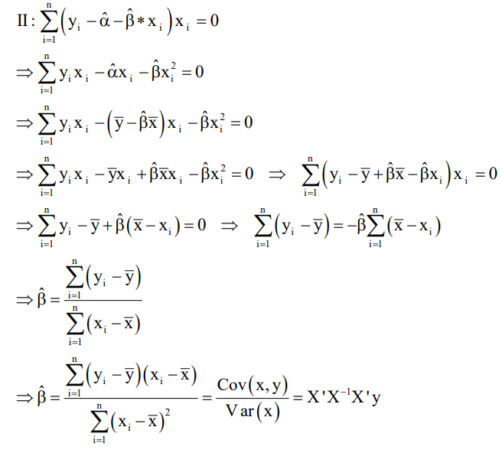
Derivation of Regression Coefficients
Solving the second equation for beta (β)

Slide 13
Regression vs Correlation
Correlation: No assumption on dependence on each other; Just a degree of association
Regression: One-way causal effect from explanatory to response variables

Slide 14
Correlation Coefficient
Measures the direction and strength of a linear association
Direction of a linear association can be positive or negative
Strength of a linear association can be near zero, moderate or strong
Use of the term correlation and calculation of the correlation coefficient should not be applied to non-linear relationships…..where the association between two variables can be modeled better with a curve rather than a straight line

Slide 15
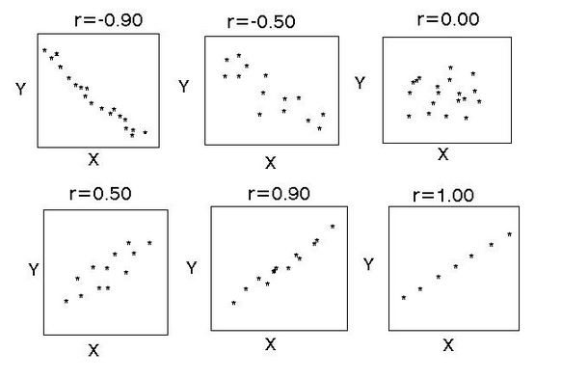
Correlation Coefficient

Slide 16
Correlation Coefficient
Between -0.5 and 0.5 = no association
Between 0.5 to 0.8 =moderate positive association
0.8+ = strong positive association
Between -0.5 to -0.8 = moderate negative association
-0.8+ - strong negative association

Slide 17
Assumptions of Linear Regression
Linear relationship
Multivariate normality
No or little multicollinearity
No auto-correlation
Homoscedasticity

Slide 18
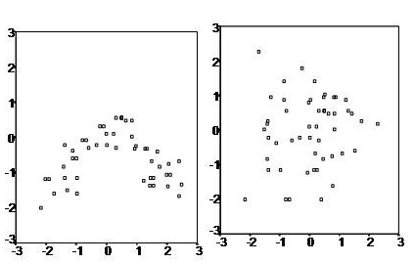
Assumptions of Linear Regression
The linearity assumption can best be tested with scatter plots, the following two examples depict two cases, where no and little linearity is present.

Slide 19
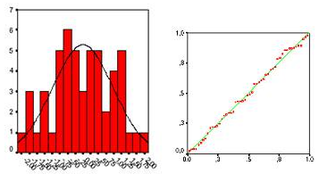
Assumptions of Linear Regression
Secondly, the linear regression analysis requires all variables to be multivariate normal. This assumption can best be checked with a histogram or a Q-Q-Plot. When the data is not normally distributed a non-linear transformation (e.g., log-transformation) might fix this issue.

Slide 20
Assumptions of Linear Regression
Thirdly, linear regression assumes that there is little or no multicollinearity in the data. Multicollinearity occurs when the independent variables are too highly correlated with each other.
Multicollinearity may be tested with three central criteria:
1) Correlation matrix - correlation coefficients among independent variables should be below |0.5|.
2) Tolerance – the tolerance measures the influence of one independent variable on all other independent variables. Tolerance is defined as T = 1 – R² ; it should be above 0.1
3) Variance Inflation Factor (VIF) – the variance inflation factor of the linear regression is defined as VIF = 1/T. With VIF > 10 there is an indication that multicollinearity may be present

Slide 21
Assumptions of Linear Regression
Fourth, linear regression analysis requires that there is little or no autocorrelation in the data. Autocorrelation occurs when the residuals are not independent from each other over time. In other words, the value of y(x+1) is not independent from the value of y(x).
You can test the linear regression model for autocorrelation with the Durbin-Watson (d) test.
As a rule of thumb values of 1.5 < d < 2.5 show that there is no auto-correlation in the data.

Slide 22
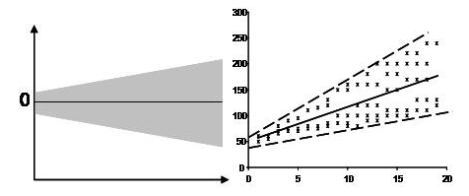
Assumptions of Linear Regression
The last assumption of the linear regression analysis is homoscedasticity. The scatter plot is good way to check whether the data are homoscedastic (meaning the residuals are equal across the regression line).
The Goldfeld-Quandt Test can also be used to test for heteroscedasticity. The test splits the data into two groups and tests to see if the variances of the residuals are similar across the groups.

Slide 23
Linear Regression Validation: Explanation
Omnibus test of the model (test of the overall fit of the model): F-test (i.e., tested using F statistic)
Fmodel > Fcritical for a given level of significance (i.e., either α = 0.05 or α = 0.01)
Test of individual regression coefficients: t-test (i.e., tested using t-statistic):
tcalc > tcritical for a given level of significance (i.e., either α = 0.05 or α = 0.01)

Slide 24
Linear Regression Validation: P-value
Same for both correlation and regression
The P-value is the probability that you would have found the current result if the correlation coefficient were in fact zero (null hypothesis).
If this probability is lower than the conventional 5% (P<0.05) the correlation coefficient is called statistically significant. (reject null hypothesis)
Need a p-value lower than 0.05 to show a statistically significant relationship between X and Y
“a P value of less than 0.05 means that you are less than 5% certain that the association found could have been due to random chance. There’s less than a 5% chance that there is actually no association at all….even though the model is saying there is”.

Slide 25
Other Diagnostic Considerations
The model might be improved by including additional input variables
However, the adjusted R² applies a penalty as the number of parameters increases
Residual plots should be examined for outliers
Points markedly different from the majority of points
They result from bad data, data processing errors, or actual rare occurrences
Finally, the magnitude and signs of the estimated parameters should be examined to see if they make sense

Slide 26
Linear Regression Validation: Prediction
Explanatory models focus on goodness-of-fit while prediction models are concerned with predictive accuracy.
A good predictive model should have high predictive accuracy when applied to new records.
Measures used to assess predictive accuracy are based on the validation dataset (first estimate (aka train) the model using training dataset and then assess predictive accuracy using validation dataset).

Slide 27

Linear Regression Validation: Prediction
Predictive Accuracy Measures
The prediction error of record i is defined as the difference between its actual outcome and its predicted outcome value: ε_{i} = y_{i} – ŷ_{i}
Popular measures of predictive accuracy
MAE (mean absolute error):

Slide 28
Linear Regression Validation: Prediction
ME (mean error) – same as MAE but retains the sign of the errors (i.e., gives an indication of whether the predictions are on average over- or under-predicting the outcome variable
MPE(mean absolute percentage error) – gives the percentage error of how predictions deviate from the actual values (on average), taking into account the direction of the error.
MAPE (mean absolute percentage error) – same as MPE but ignores the sign of the error

Slide 29

Linear Regression Validation: Prediction
RMSE (root mean squared error) – similar to the standard error of estimate of the explanatory model, except that it is computed on the validation dataset rather than on training data.

